Slide 1
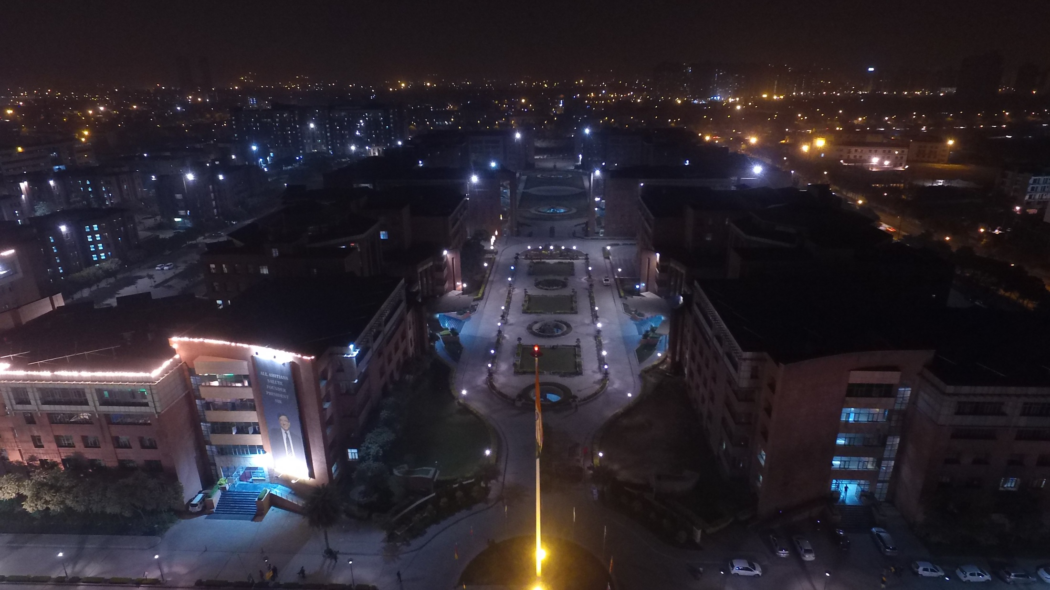
Amity International Business School
The Best Business School of ASIA

Slide 2
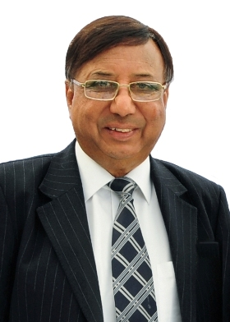
VISION
“We Endeavor
to become an efficient institute committed towards innovation, sharing,
knowledge, openness
& entrepreneurial skills
to develop Global Managers.
We have passion for knowledge,
teamwork and a caring attitude.”
Dr.Ashok K Chauhan
Founder President , RBEF &
Chairman ,
AKC Group of Companies

Slide 3
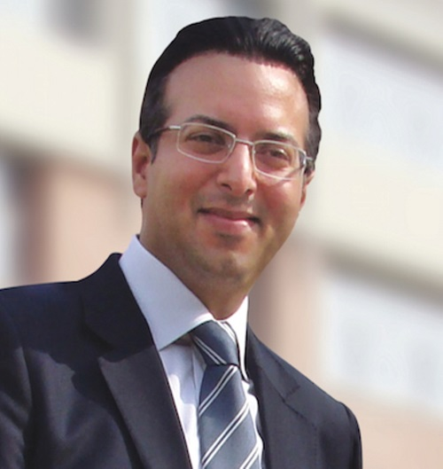
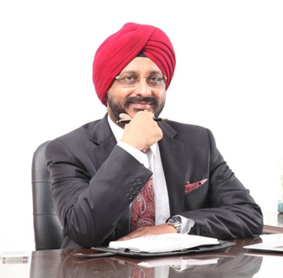
mission
“To develop
the all round personality of students
by making them not just excellent professionals
but also good individuals with understanding & regard for human values, pride in their heritage and culture,
a sense of right & wrong
and a yearning for perfection.”
Dr. Atul Chauhan
Chancellor
Amity University
Prof. (Dr.) Gurinder Singh
Amity Group
Vice Chancellor & DG (AIBS)
Amity University

Slide 4
Amity International Business School
PRESENTS

Slide 6
Program Schedule INBUSH ERA 2017
DAY 1
Inauguration
DAY 2
Plenary Session
Day 3
Valedictory Function
Plenary Session
Cultural Competition
Cultural night
Cultural night
8th February 2017
9th February 2017
10th February 2017

Slide 7
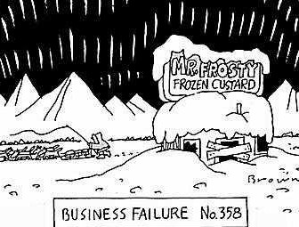
EVENTS AT INBUSH
BUSINESS QUIZ DEBATE
Case Study Business Plan

Slide 8
EVENTS AT INBUSH
RESEARCH PAPER AD - MAD
Stock Simulation Lan Gaming

Slide 9
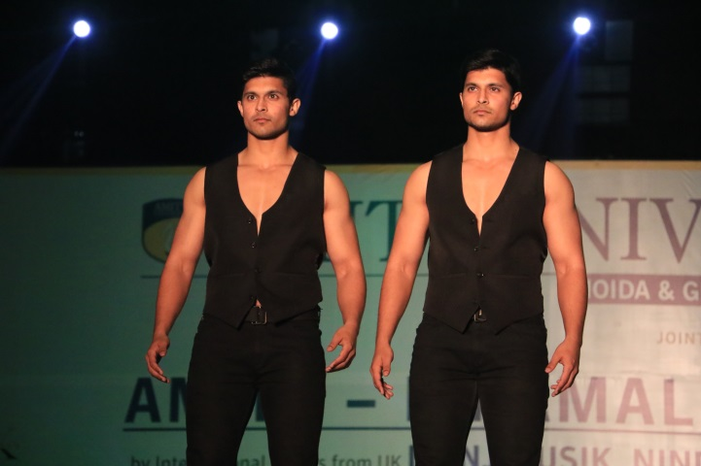
EVENTS AT INBUSH
CHOREOGRAPHY ROCK SHOW
FASHION SHOW STUDENTS NIGHT

Slide 10
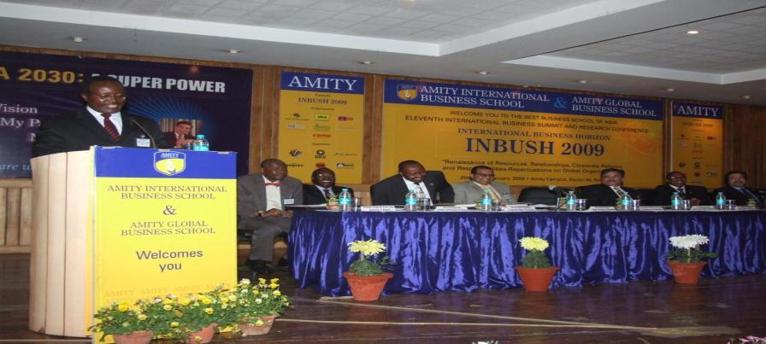
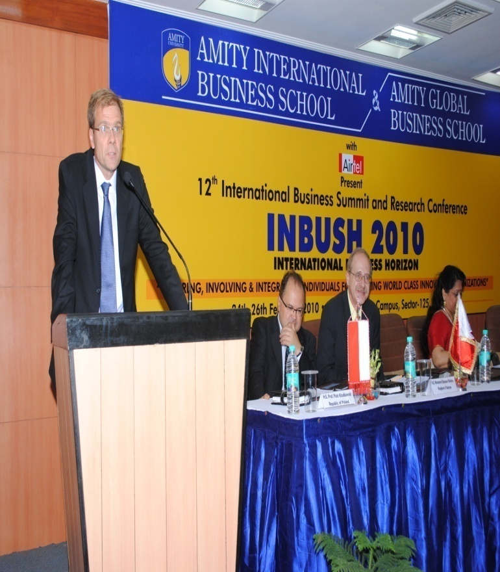
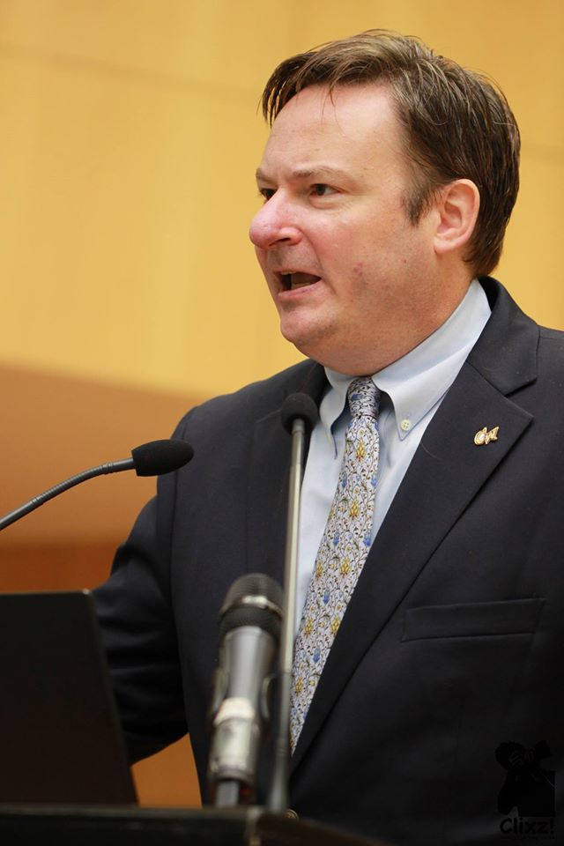
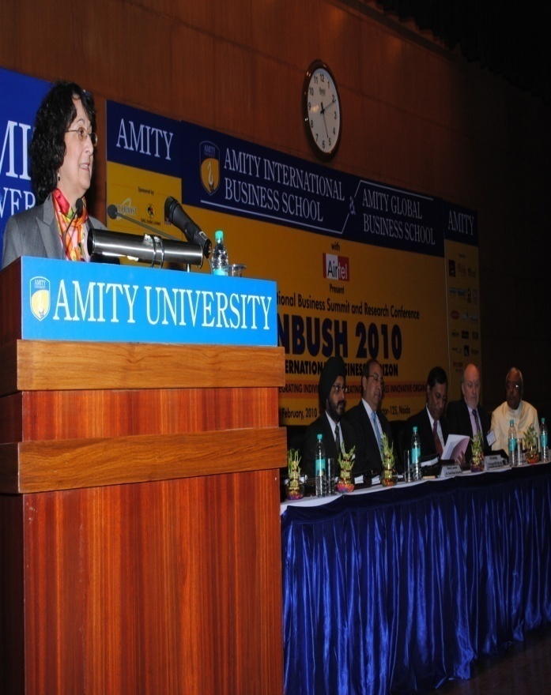
FOREIGN DIPLOMATS
Presence of Foreign Diplomats

Slide 11
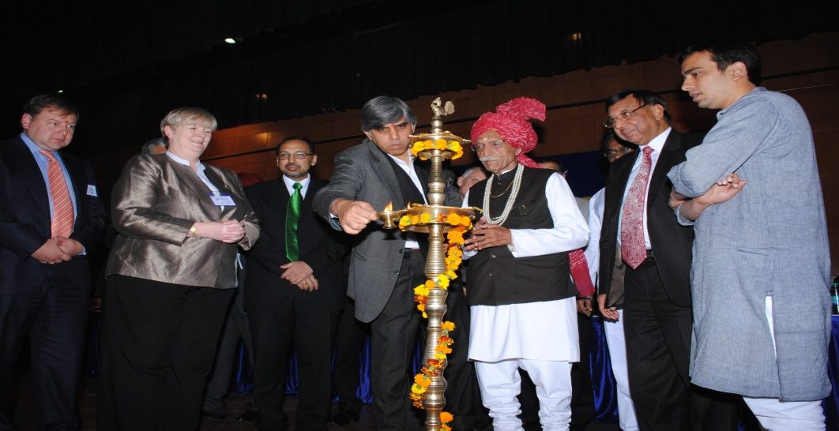
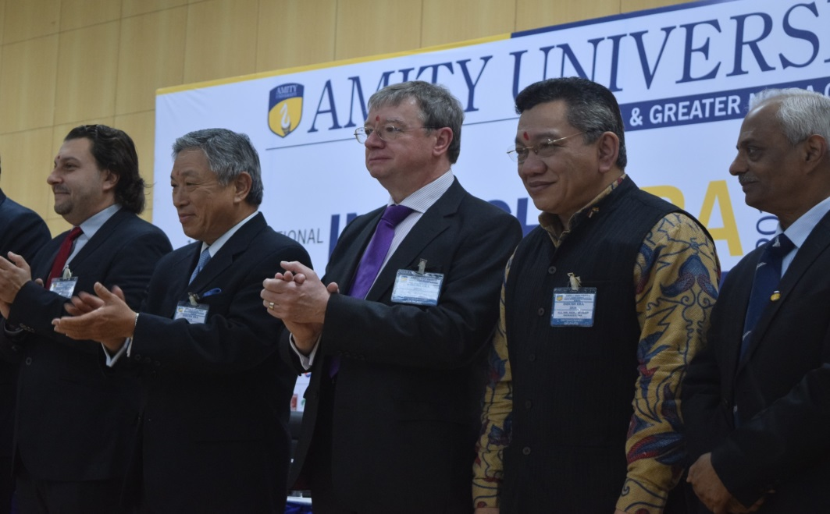
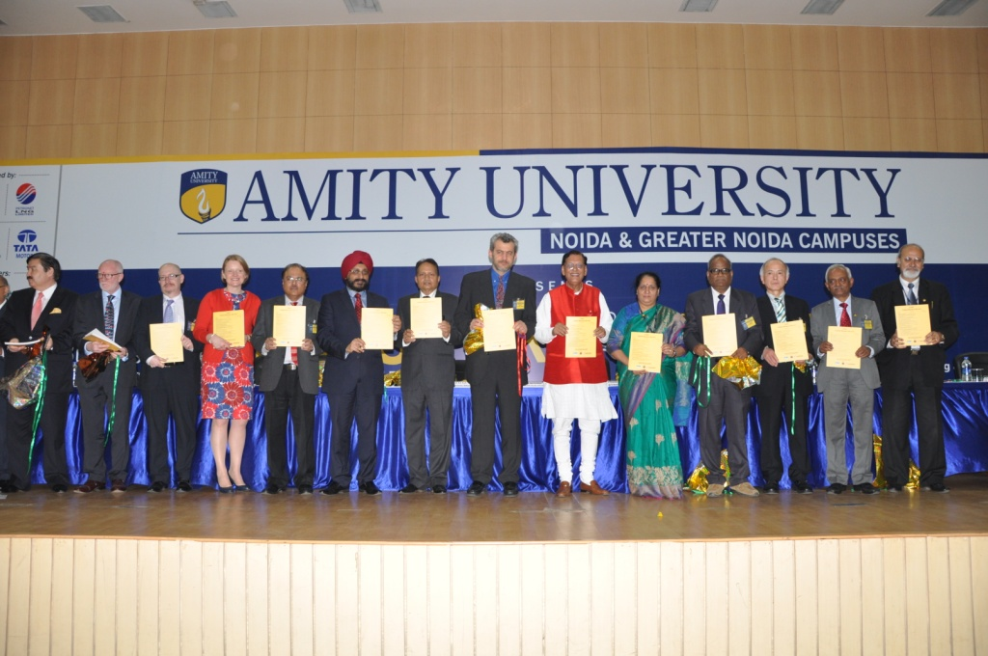
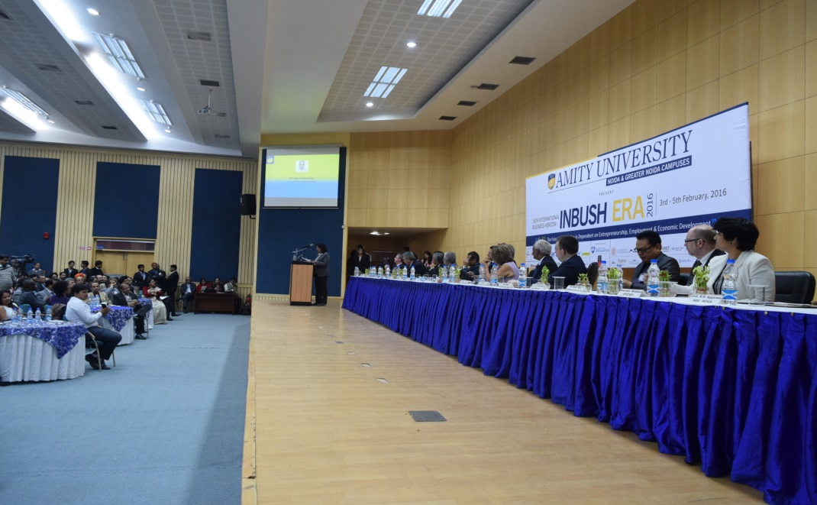
DELEGATES AT INBUSH

Slide 12
Eminent Speakers at Amity UNIVERSITY
Tom Peters
Sir John Fraser Robinson
Dr.Robert Kaplan
Prof Bernard Schmith
Shiv Khera
Al & Laura Ries

Slide 13
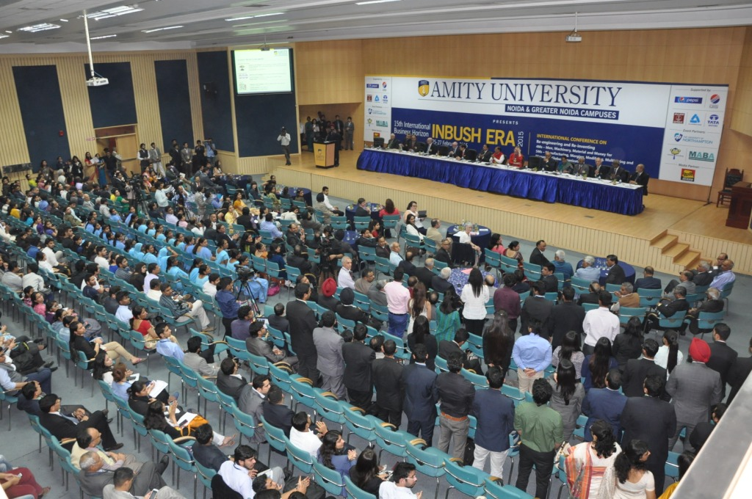
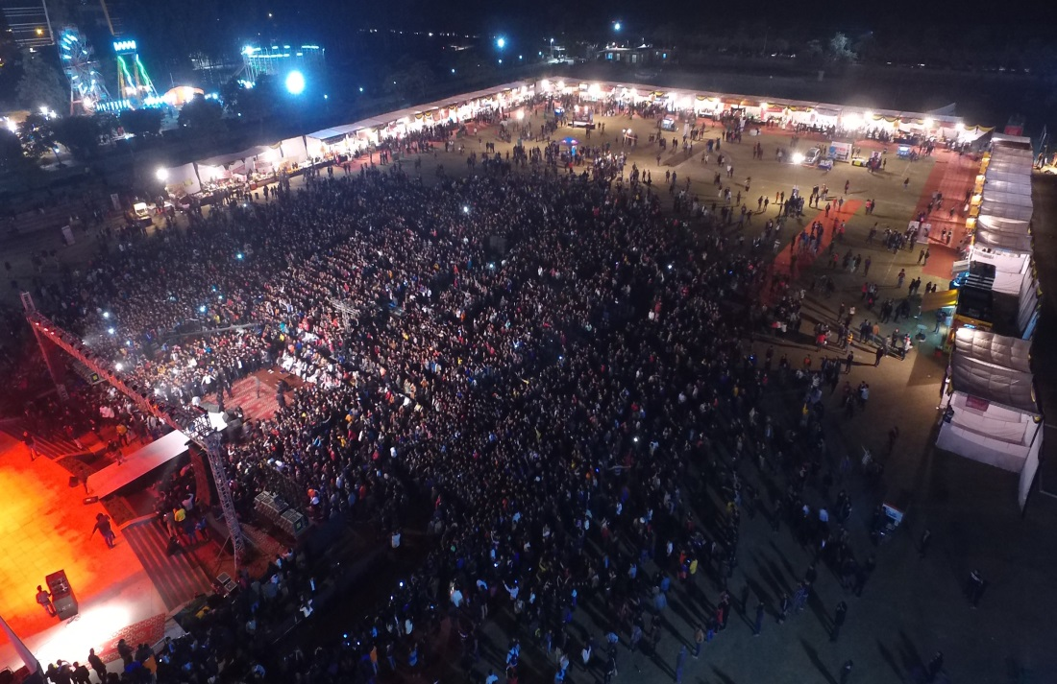
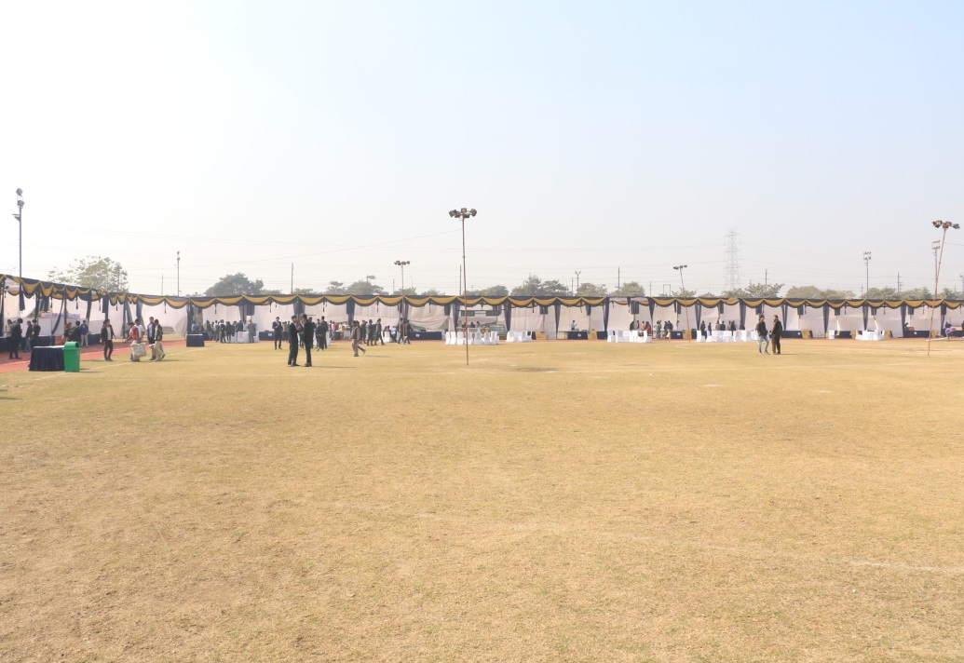
VENUE
Stalls
(7ft x 15ft)

Slide 14
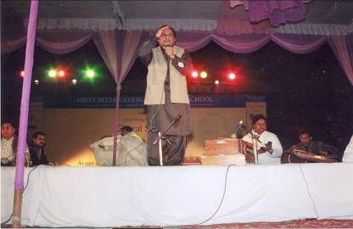
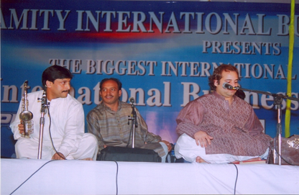
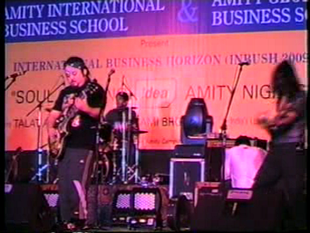
Grand Fiesta
Cultural Evening
GHULAM ALI
RAHAT FATEH ALI KHAN
PARIKRIMA
NIZAMI BROTHERS

Slide 15
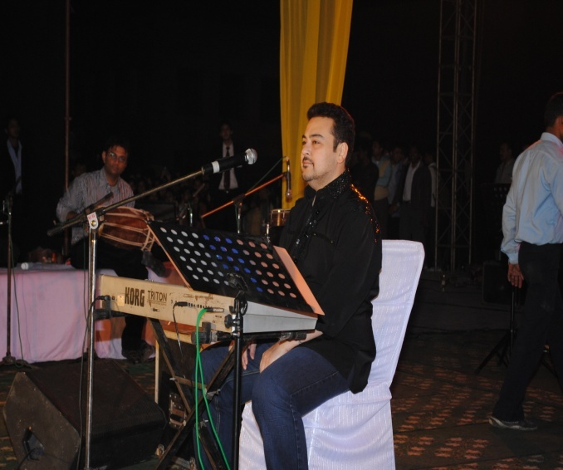
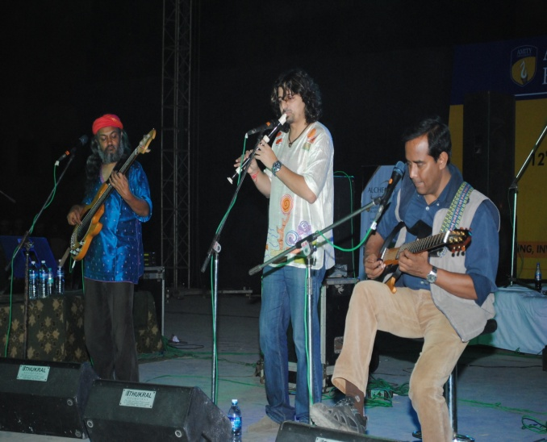
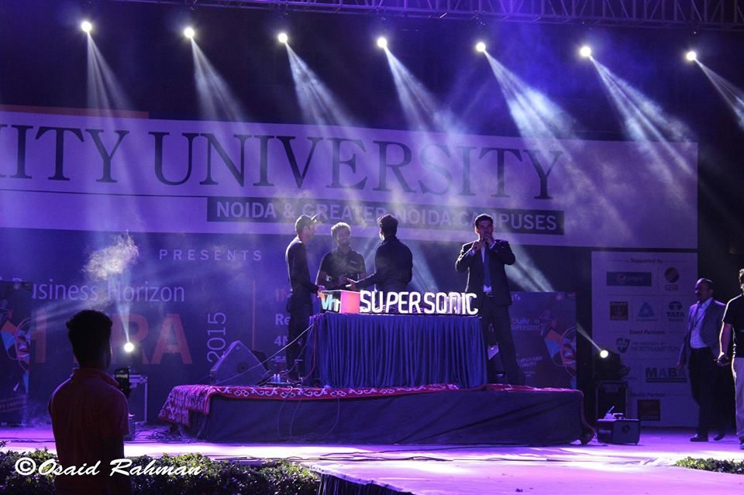
Grand Fiesta
ADNAM SAMI
INDIAN OCEAN
DJ PASHA DOLL
PROGRESSIVE BROTHERS

Slide 16
Grand Fiesta
Amelle Berrabah
Palash Sen
Sonu Nigam
Adnam Sami

Slide 17
Grand Fiesta
RDB

Slide 18
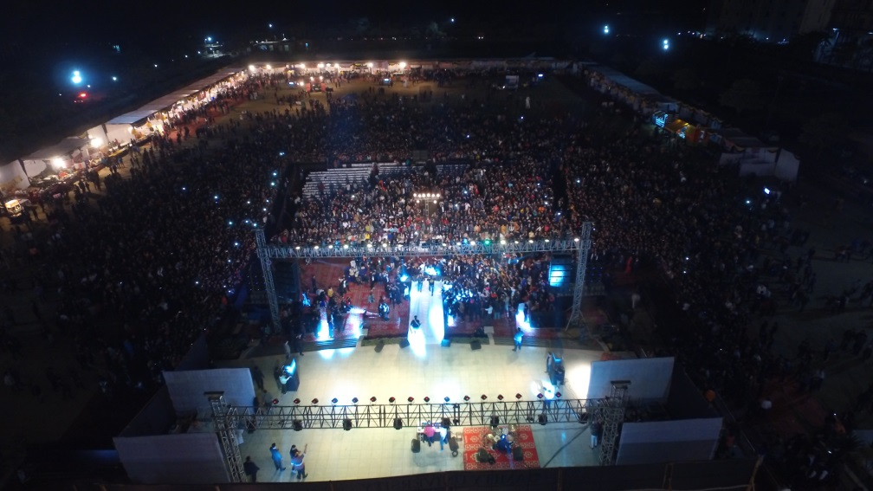
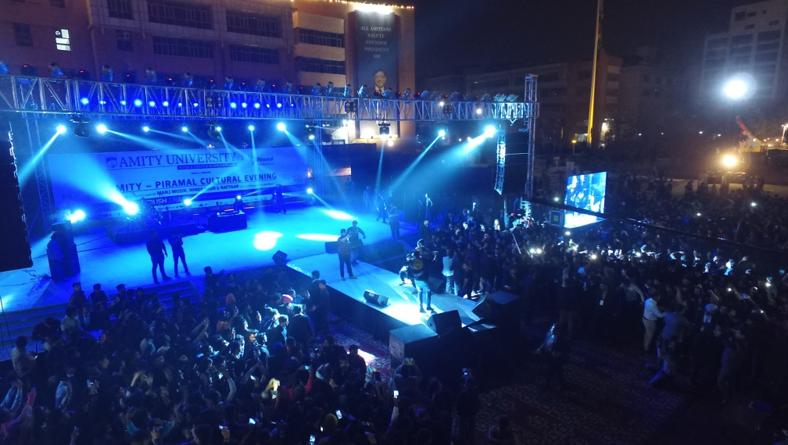
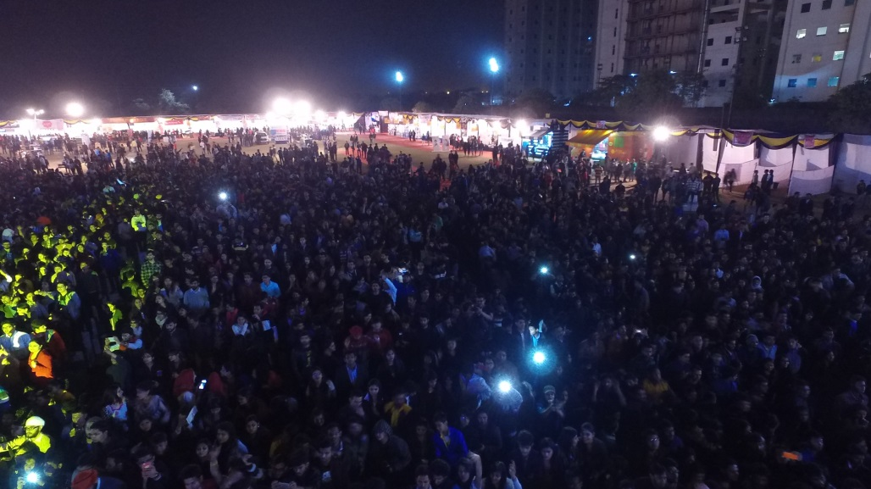
Grand Fiesta

Slide 19
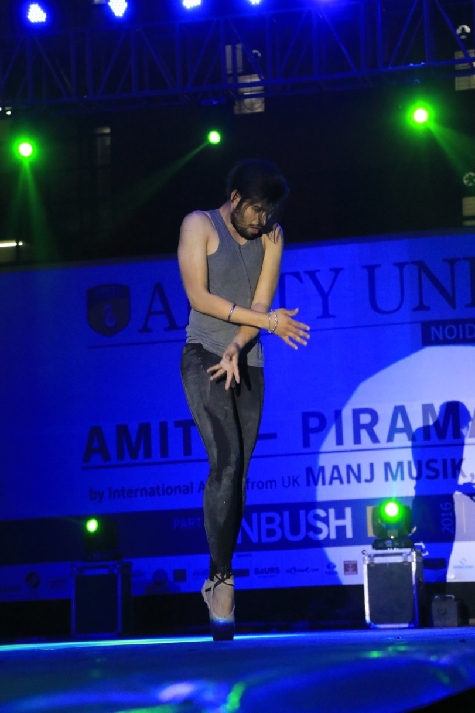
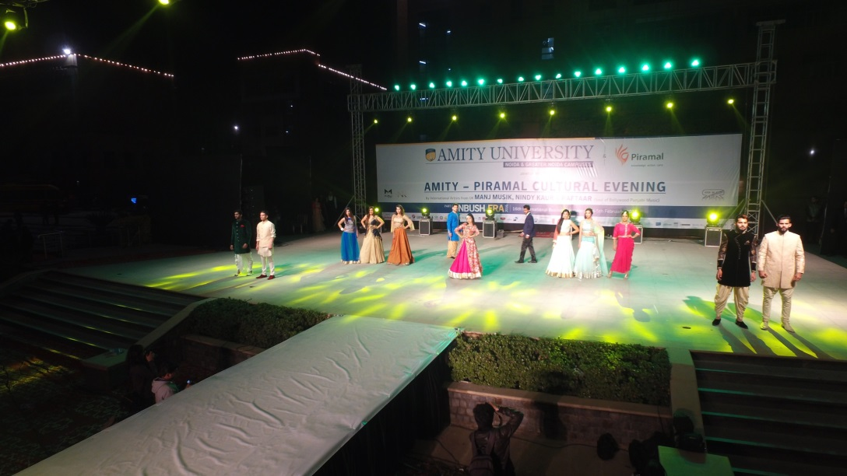
GRAND FIESTA

Slide 20
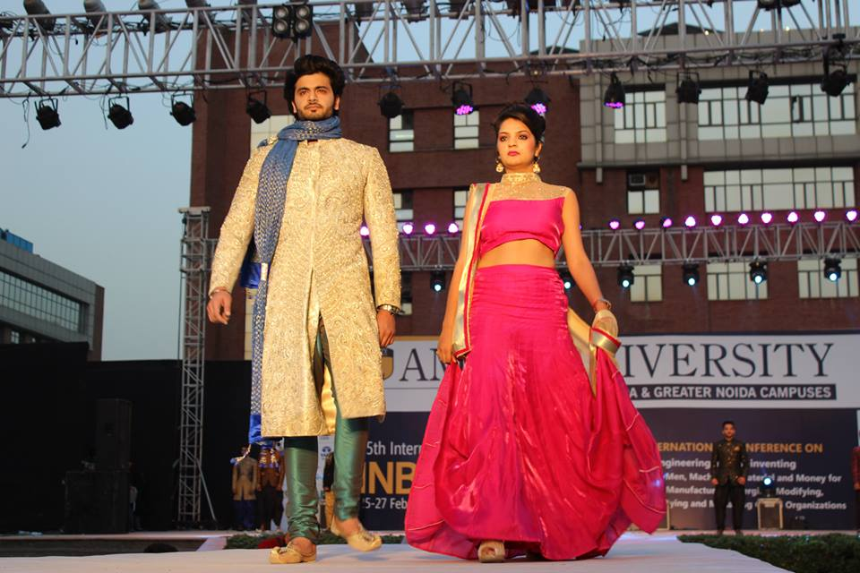
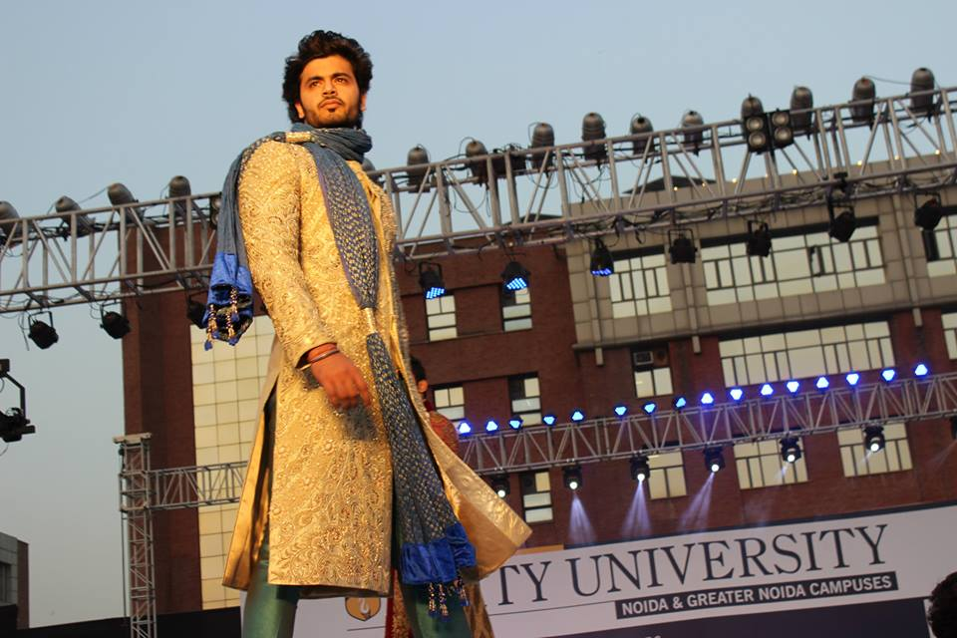
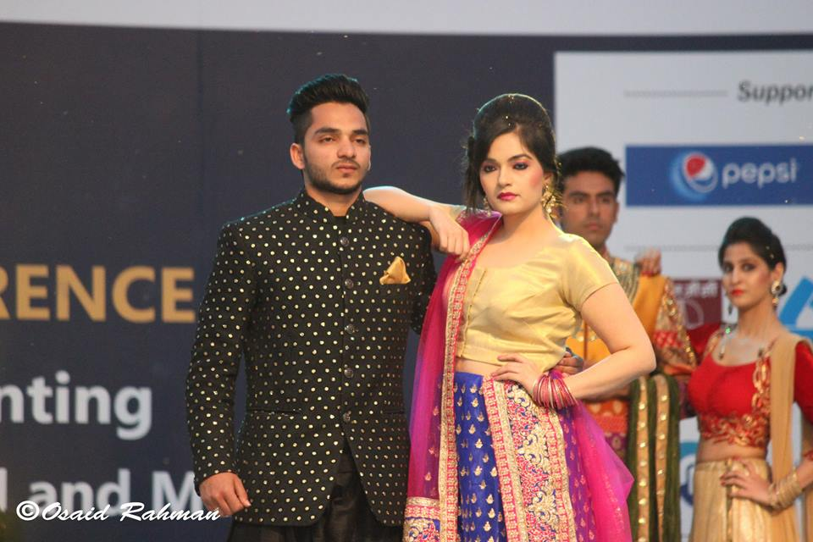
SNAPSHOTS OF INBUSH

Slide 21
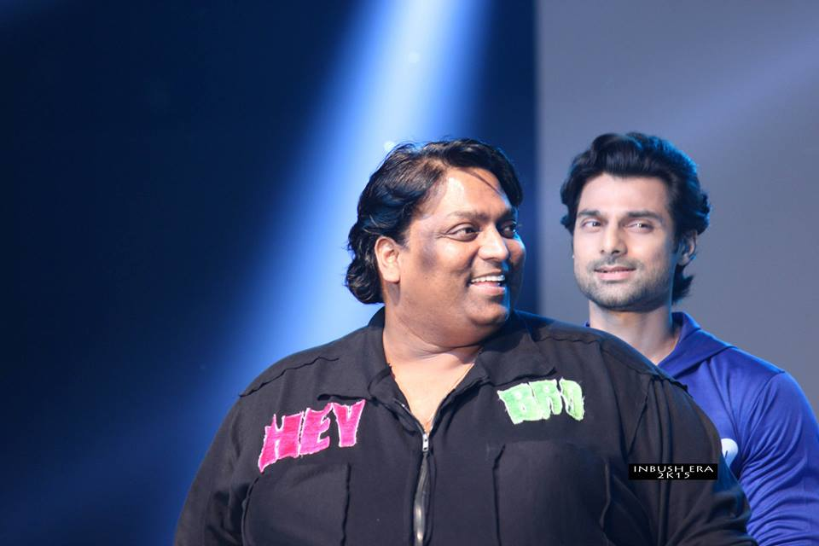
SNAPSHOTS OF INBUSH

Slide 22
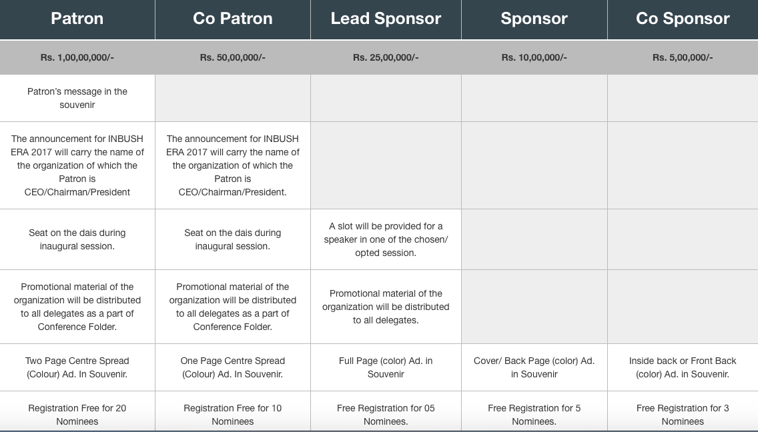
INBUSH ERA 2017
Biggest International Business & Technology Summit and Research Conference
8th – 10h February 2017
Sponsorship Categories

Slide 23
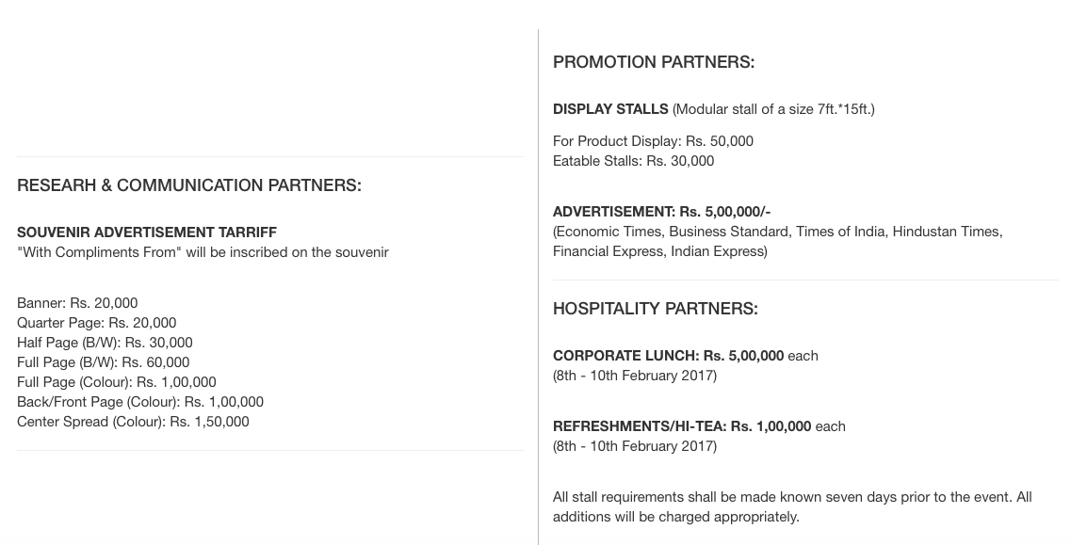

Slide 27
Looking forward to your participation in
INBUSH ERA 2017…

Slide 28
THANK YOU..

