Slide 1
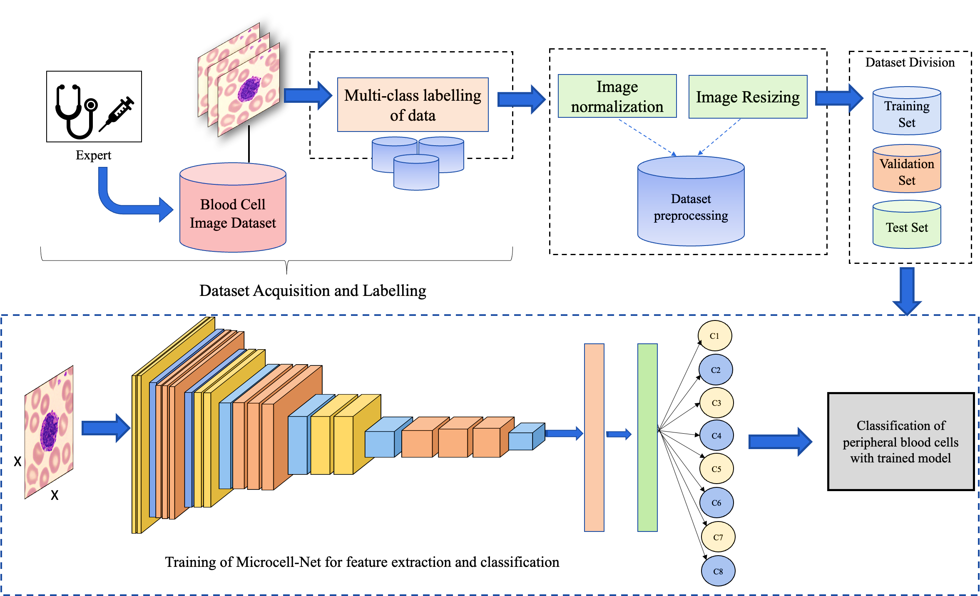
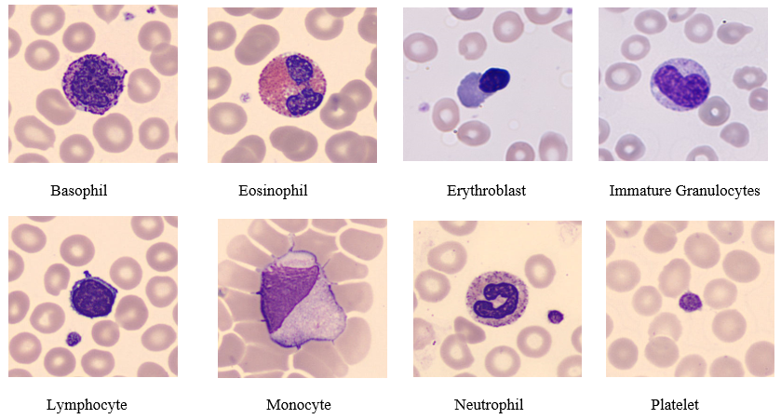
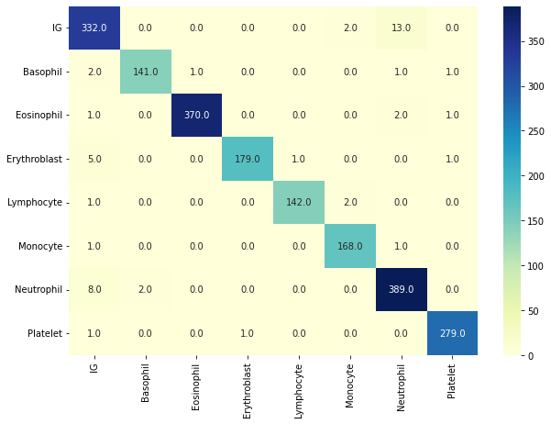
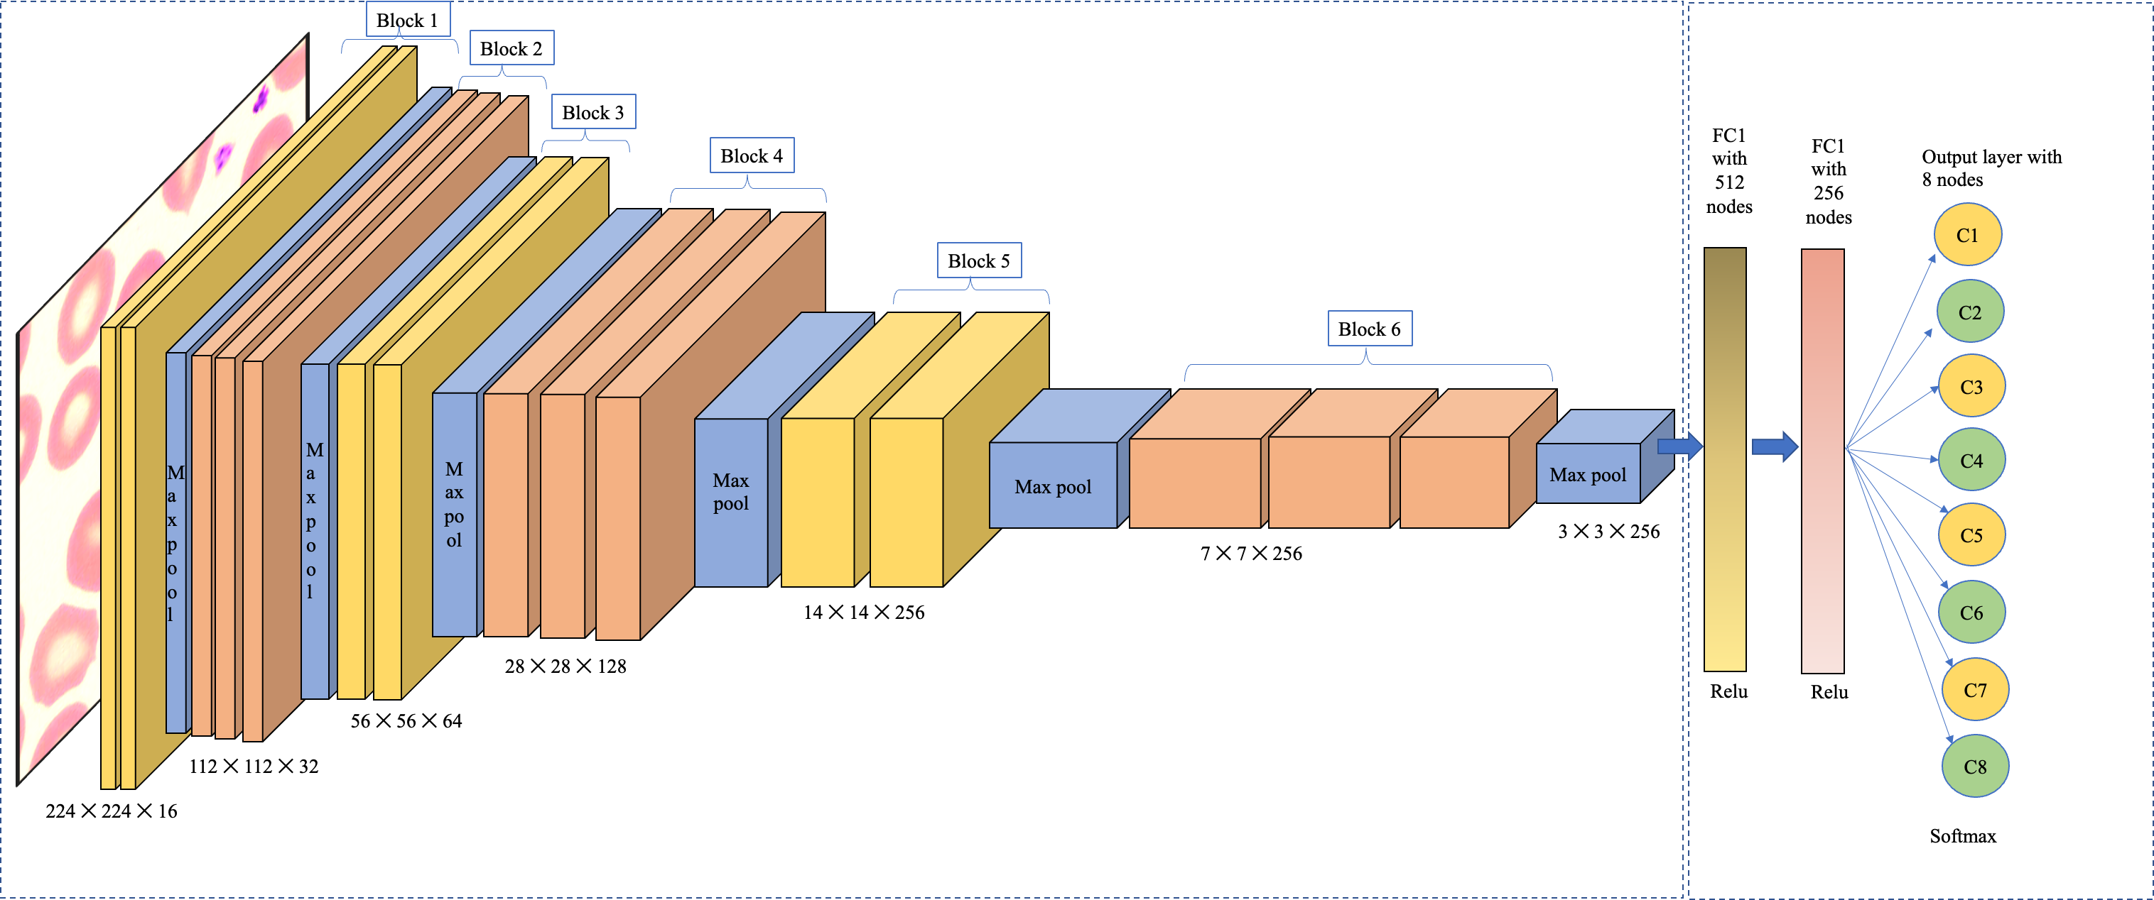
A Deep Neural Network for Multi-Class Classification of Microscopic Blood Cell Images
MOTIVATION
METHODOLOGY
EXPERIMENTAL RESULTS
Blood cells are playing an important role to defend the human body from several kinds of infections and diseases. The majority of blood cells come from bone marrow, with only a few cells coming from the human body's glands. Blood-related diseases are one of the major concerns in the biomedical domain and most of the disease symptoms are reflected through the analysis of blood cells. The diagnosis by experts in laboratories is very costly and time-consuming, thus artificial intelligence-based systems can help in the automatic diagnosis and monitoring of an individual's health.
The proposed CNN model Microcell-Net is a deep learning model consisting of 15 convolutional layers organized in six convolutional blocks, max pooling and an eight-class classification head as the output layer. It is a self-learning type architecture where learning and automatic weight adjustment take place which eliminates the requirement of manual comparison to other models as it reduced the burden of computing feature extraction and feature selection in the learning process of classification and it also reduces the total parameters used for training the Microcell-Net.
The proposed CNN architecture Microcell-Net is trained with microscopic blood smear images and tested on the test set of the same dataset. To make the model more generalized and to overcome the problem of overfitting a batch normalization layer is employed before fully connected layers which also improves the faster convergence of the proposed model Microcell-Net. After performing a number of experiments, it is found that the model Microcell-Net is optimized and robust in nature as it gives the best classification results in comparison to other proposed models and existing models.
DATASET DETAILS
Comparative analysis of the proposed model with other CNN models
The dataset utilized in this work is from a public dataset which consists of 17,092 images of peripheral blood smears of healthy individuals without infections or oncologic disease. The dataset comprises eight cells categorised as immature granulocytes (2895), basophils (1218), eosinophils (3117), erythroblasts (1551), lymphocytes (1214), neutrophils (3329), monocytes (1420), and platelets (2348).
Model | Validation Accuracy | Test Accuracy | Number of Parameters
VGG-16 | 94.78% | 90.00% | 1,49,15,400
VGG-19 | 93.49% | 90.00% | 2,02,25,096
Inception V3 | 90.64% | 88.00% | 2,18,19,176
ResNet50 | 61.37% | 44.00% | 3,20,02,824
Mobile Net | 76.82% | 72.64% | 32,48,008
Alex Net | 95.38% | 91.40% | 4,67,85,288
Microcell Net with batch normalization | 98.76% | 97.65% | 44,21,432
Microcell-Net with batch normalization
Confusion matrix
Sample dataset images of microscopic blood cells in eight categories
Category | Precision | Recall | F1-Score | Accuracy
Basophils | 0.99 | 0.95 | 0.97 | 97.65%
Eosinophils | 1.00 | 0.99 | 0.99
Erythroblasts | 0.99 | 0.97 | 0.97
Immature granulocytes | 0.91 | 0.95 | 0.93
Lymphocyte | 0.98 | 0.97 | 0.98
Monocyte | 0.97 | 0.98 | 0.97
Neutrophil | 0.95 | 0.96 | 0.95
Platelet | 0.99 | 1.00 | 0.99
Block diagram of the proposed CNN-based automatic microscopic blood cell image classification system
Cell type | Number of images | Percentage (%)
Basophil | 1,218 | 7.13
Eosinophil | 3,117 | 18.24
Erythroblast | 1,551 | 9.07
Immature granulocytes | 2,895 | 16.94
Lymphocyte | 1,214 | 7.10
Monocyte | 1,420 | 8.31
Neutrophil | 3,329 | 19.48
Platelet | 2,348 | 13.74
Total | 17,092 | 100
DETAILS:
Sample image dataset statistics
Name:
Enrollment No.:
Department:
Institute:
Email ID:
Proposed CNN architecture of Microcell-Net
E3G-12B, Amity University, Sector 125, Noida, UP. Email: ai@amity.edu www.amity.edu/acai/

