Slide 1

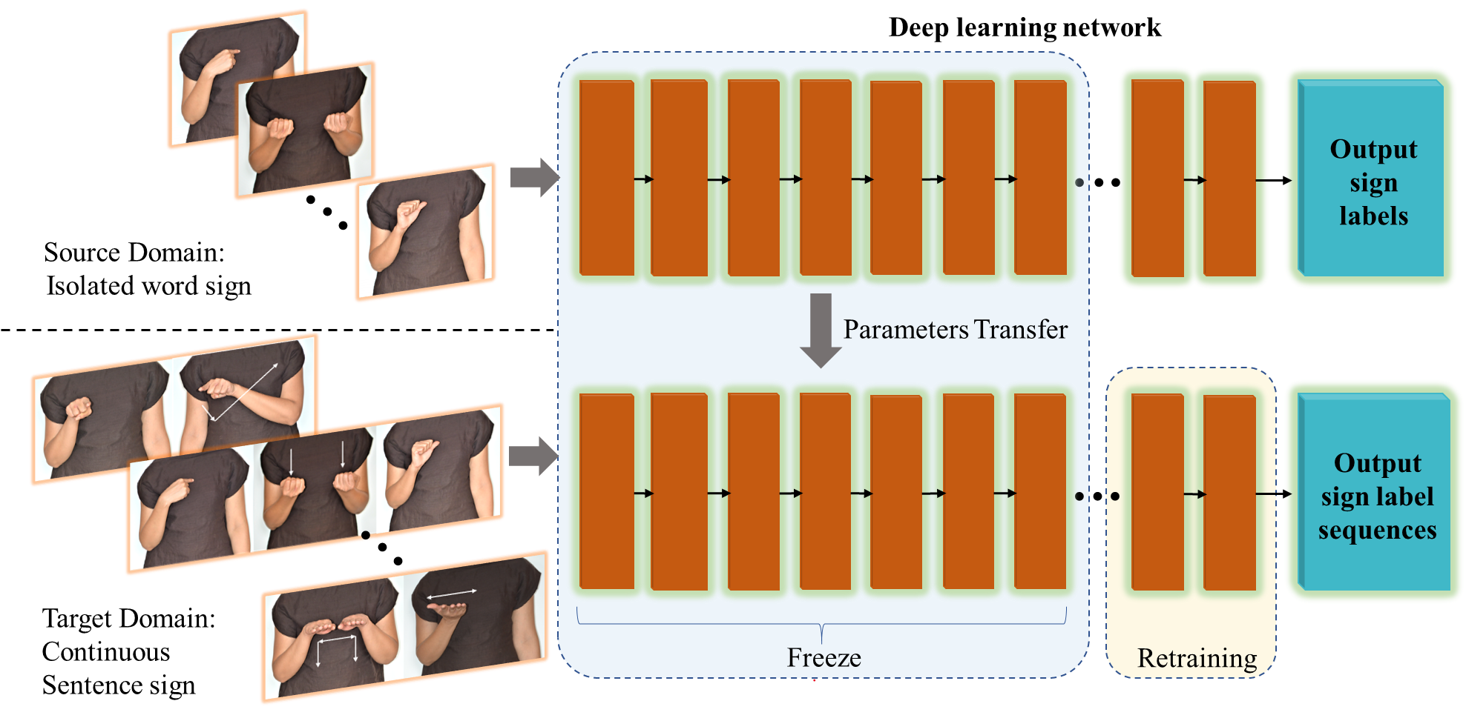
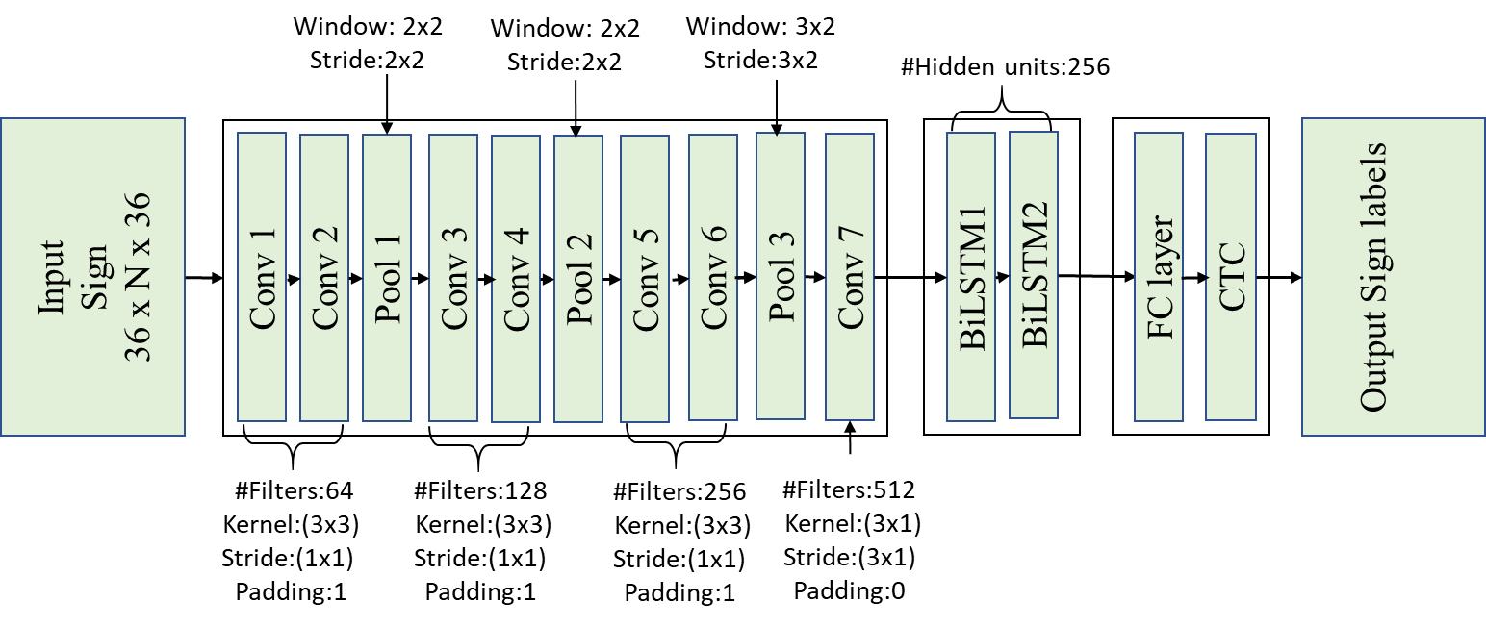

Amity Centre for Artificial Intelligence
Building a smarter world with Artificial Intelligence
Powered with Most Advanced Supercomputing Facility
Continuous Sign Language Recognition using Isolated Signs data and Deep Transfer Learning
Global speech and hearing Impairment: The global population of speech and hearing impaired people is estimated to be over 1.5 billion
Challenges for speech and hearing Impaired: Aging, cataracts, glaucoma, and more contribute to difficulties in daily tasks for visually impaired individuals.
Assistive Technology Gaps: there exists a communication gap between sign language users and those who do not understand this language. Use of human interpreters is often costly and not readily accessible. Thus, there is a requirement of developing an efficient sign language recognition (SLR) system which can help the users of sign language to conveniently communicate with non-signers.
Deep transfer learning framework
Novel contributions are as follows:
a) A novel framework for end-to- end recognition of continuous sign language is proposed by embedding transfer learning into a deep neural network architecture.
Initially, the model parameters are learned on data for isolated signs. Then, few layers of the network are retrained to enable continuous sentences recognition. The retraining requires only limited amount of sentence data with known sign sequence.
The exact boundary of each sign in the signed sentence is not required to be known. Also, the proposed architecture is capable of handling inputs of varying duration.
Data acquisition setup
Deep learning model used for end-to-end recognition of ISL
Name:
Enrollment No.:
Department:
Institute:
Email ID:
E3G-12B, Amity University, Sector 125, Noida, UP. Email: ai@amity.edu www.amity.edu/acai/

